Slide 1


Nmap Fundamentals
Network Scanning for CEH Beginners

Slide 2


What is Nmap?
Versatile Network Discovery
Nmap (Network Mapper) is the industry standard for:
Discover Hosts: Find active machines on a network
Scan Ports: Identify open communication channels
Detect Services: See what software is running
Identify OS: Fingerprint target systems

Slide 3






Why Use Nmap?
Reconnaissance
Find Entry Points
CEH Essentials
The first critical step in ethical hacking. Information gathering is half the battle.
Uncover vulnerable services and misconfigured ports used for real-world pentesting.
A fundamental tool covered extensively in the Certified Ethical Hacker (CEH) curriculum.

Slide 4





The Scanning Mechanism
Packet Analysis Cycle

Slide 5



Nmap Basic Syntax
Command Structure
Execution Example
The basic anatomy of an Nmap command is straightforward:
To perform a simple scan on a specific gateway IP address:

Slide 6
Defining Targets
Single IP: 192.168.1.1
Subnet: 192.168.1.0/24
Range: 192.168.1.1-100
Domain: example.com

Slide 7



Understanding Ports
Communication Endpoints
65k+
A port is a logical connection point used by programs to exchange data. Common examples every CEH student must know:
80
443
22
Possible Ports
HTTP
HTTPS
SSH

Slide 8
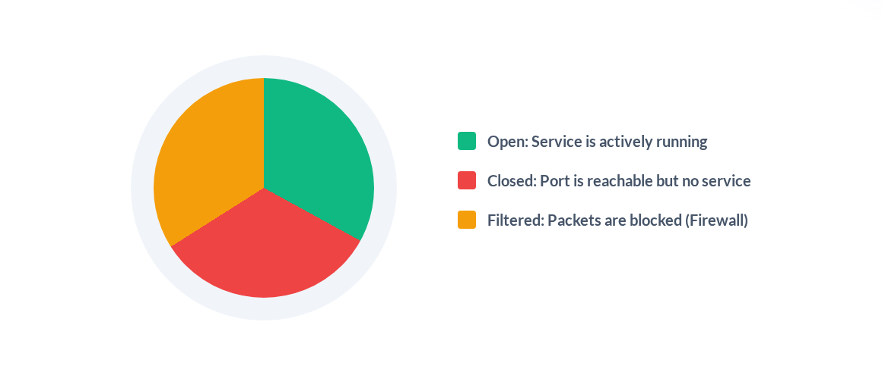
Nmap Port States

Slide 9
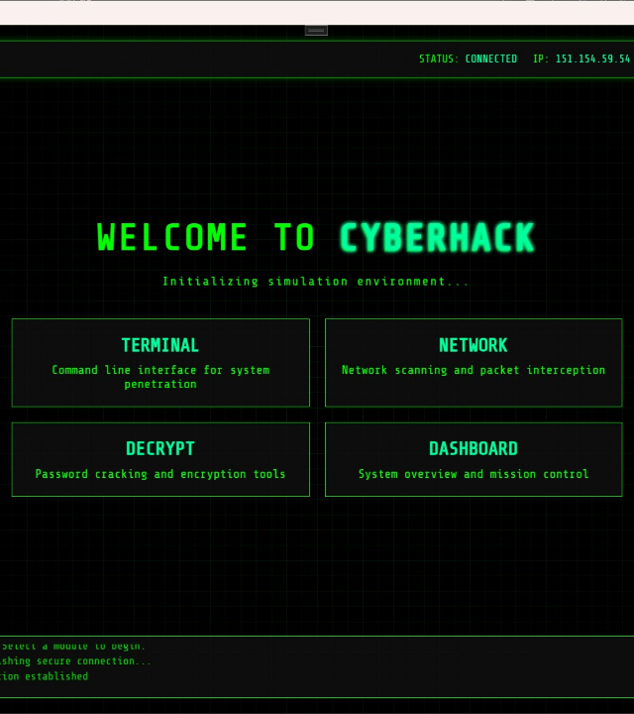

The Default Scan
Scans the top 1000 most common ports
Simple, fast, and efficient for discovery
Best starting point for any network audit

Slide 10
Primary Scan Types
Flag | Scan Name | Mechanism
-sT | TCP Connect | Full 3-way handshake (Noisy)
-sS | SYN Scan | Half-open "Stealth" scan (Faster)
-sU | UDP Scan | Scans connectionless services (DNS, DHCP)
-sn | Ping Scan | Host discovery only (No port scan)

Slide 11

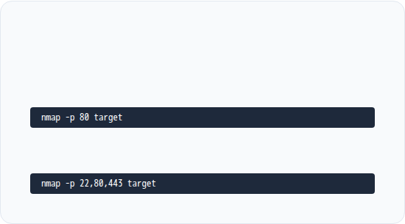

Specific Port Selection
The Complete Range
Individual & Group
To scan every single possible port (1-65535), use the dash flag:
Single port:
Multiple ports:
Warning: This takes significantly longer!

Slide 12
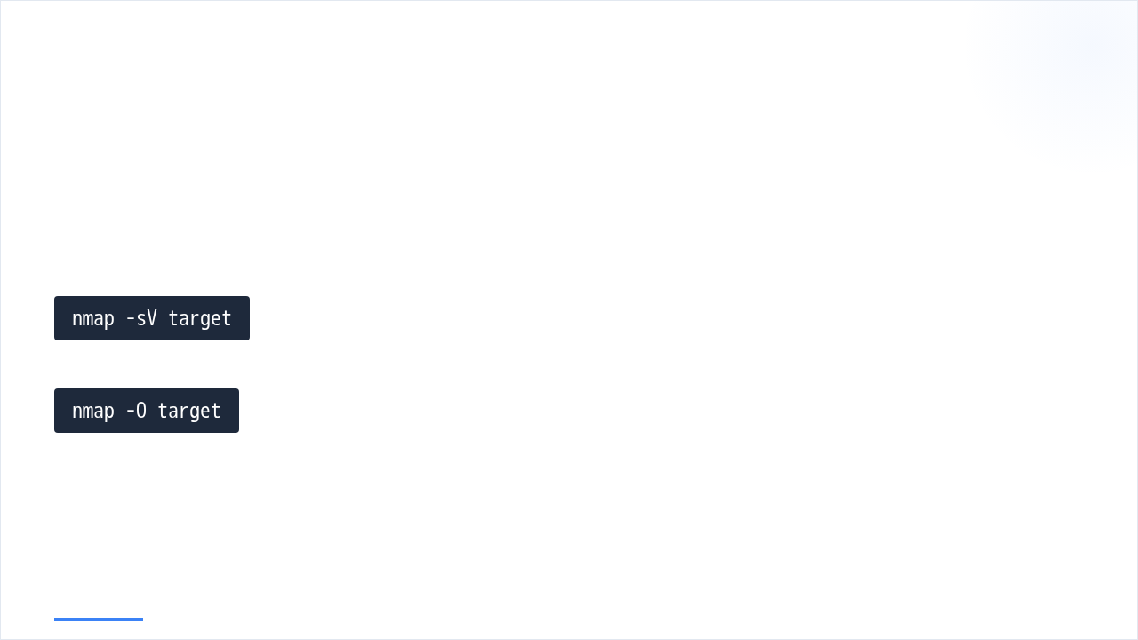

Deep Fingerprinting
Identify Versions & OS
Detects service names and version numbers.
Analyzes TCP/IP stack responses to guess the OS.

Slide 13

The Aggressive Option
Comprehensive Automation
-A
Includes OS detection, Version detection, Script scanning, and Traceroute. Be warned:
Highly Noisy
All-in-One Scan
This scan is easily detected by firewalls and Intrusion Detection Systems (IDS). Use with caution.

Slide 14
Performance & Verbosity
nmap -T4
nmap -Pn
nmap -v
Adjust these options to optimize scan speed and depth based on the target network stability.

Slide 15

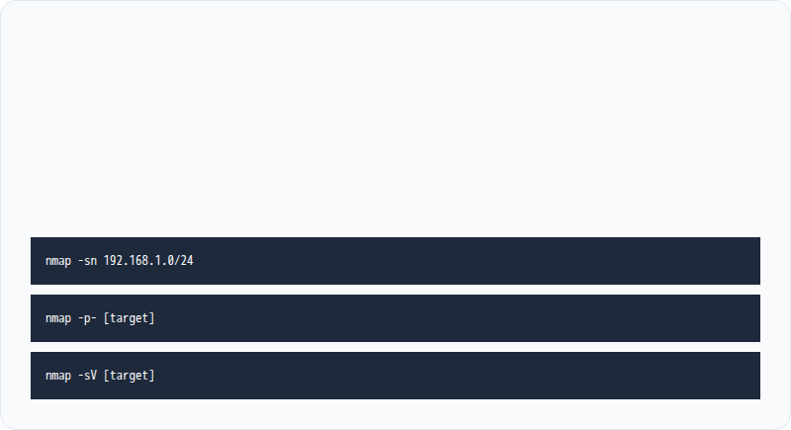
Ethics & Lab
The Rules
•
Scan only authorized systems you own or have permission for.
•
Use isolated labs or Capture The Flag (CTF) environments.
Lab Tasks

Slide 16





Image Sources
https://static.vecteezy.com/system/resources/previews/062/013/260/non_2x/minimalist-logo-design-for-cybersecurity-services-company-highlighting-security-themes-through-simple-shapes-and-color-palette-free-vector.jpg
Source: www.vecteezy.com
https://png.pngtree.com/thumb_back/fw800/background/20260112/pngtree-futuristic-blue-digital-network-grid-with-glowing-nodes-and-connections-in-image_21068420.webp
Source: pngtree.com
https://store-images.s-microsoft.com/image/apps.17806.14401632683025096.4737d292-0979-46c1-ba89-1046ba8a9659.dee3f6d1-76c9-499a-b691-78bb4c5d28ec
Source: apps.microsoft.com
https://media.istockphoto.com/id/1148196201/photo/shot-of-modern-data-center-with-multiple-rows-of-operational-server-racks-modern-high-tech.jpg?s=612x612&w=0&k=20&c=fgc6Mpefz4ekye3mryBH_GeRXkLaIuN5_-VSkBbkzFo=
Source: www.istockphoto.com
https://static.vecteezy.com/system/resources/previews/075/891/869/non_2x/legal-protection-shield-icon-set-for-law-justice-and-rights-security-vector.jpg
Source: www.vecteezy.com

